Slide 1


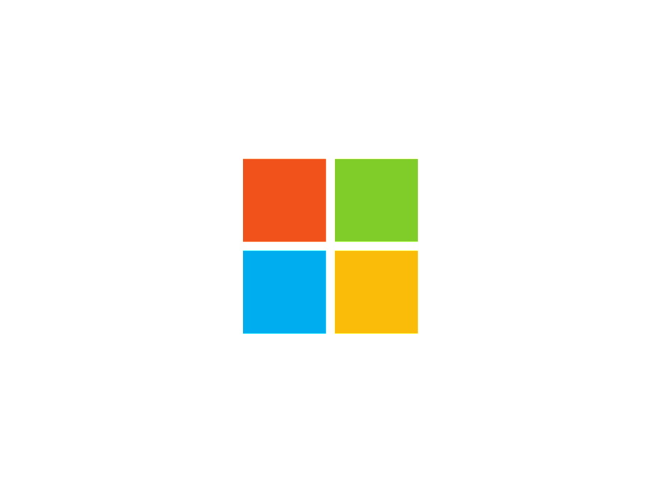
The World of Windows Security
@Antonlovesdnb
An Introduction

Slide 2
About Me
Huge Noob
Certs
InfoSec for 7ish years
Academic Background → Service Desk → InfoSec Assurance → InfoSec Tech Side
Work at Equitable Life Insurance in Waterloo
SIEM, Vulnerability Management ++

Slide 3
Agenda
The new Microsoft
Where to get started
Down the rabbit hole
Skills → Career

Slide 4
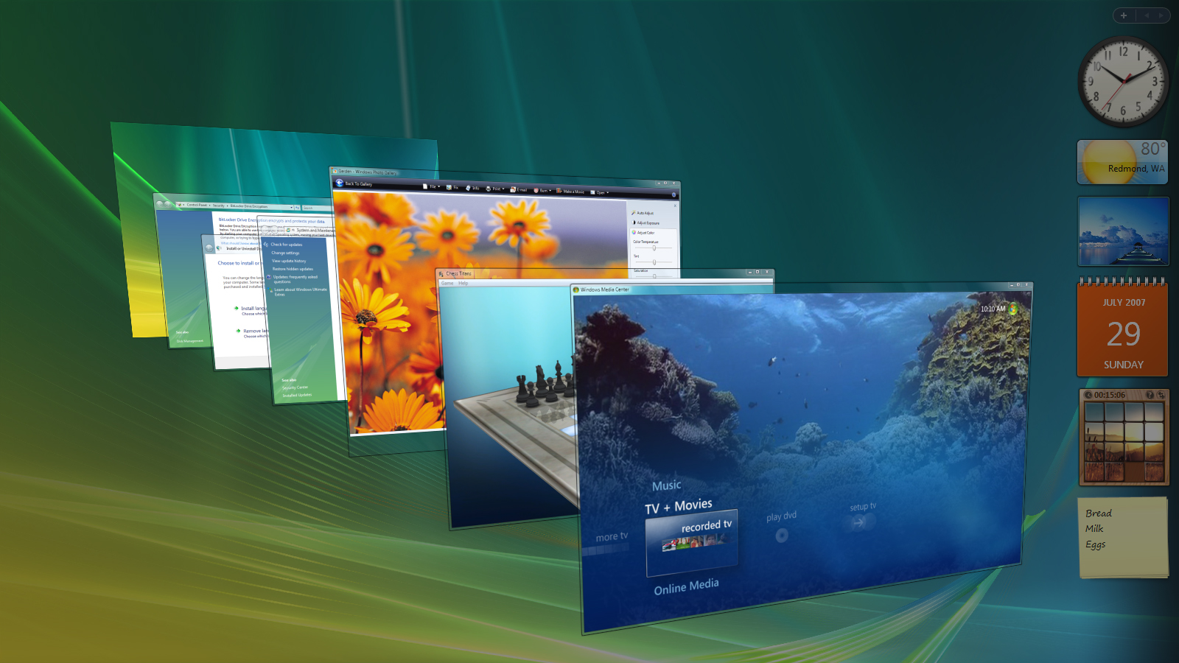
Notes:
- Microsoft is not in the Windows Vista era anymore, forgot about that misconception

Slide 5
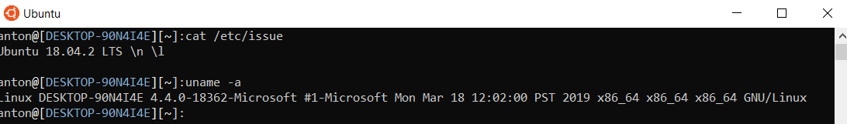
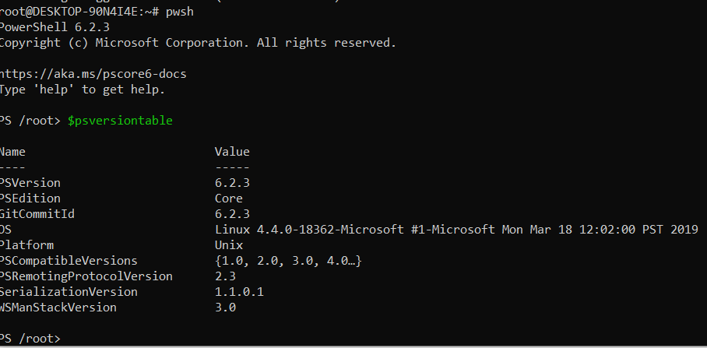
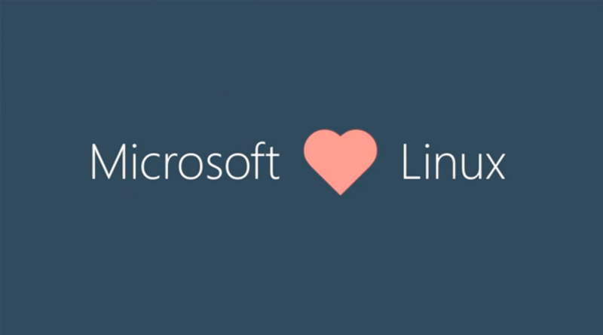
Notes:
- You can now run Ubuntu on your Windows 10 machine and run PowerShell within that Ubuntu instance. Microsoft supports Linux now and is a huge player in the open source and developer community

Slide 6
Windows Security = Big Tent
AppSec
Cloud
Web Technologies
IOT/Embedded
Endpoints
Assurance
Linux
Docker / Kubernetes
Big Data
Traditional DBs
And we need you ☺
Notes:
Whatever your area of interest of focus is in the infosec world, there is plenty of room for you in the Windows security world
Windows is a player now in things like big data, Kuberenetes, DevOps, CI etc
Windows security needs people with a broad skillset and different points of views

Slide 7
Where do I get started?
What do common Windows attacks look like?
What data do I need to help me detect these attacks?
What are the main weaknesses in Active Directory?
What are the best practices for securing AD
Without breaking everything ☺
What is the Windows attack surface?
Notes:
I got started by asking these main questions and still ask them to this day

Slide 8
Attack Surface/ Common Attacks
Exposed Services
Remote Desktop
Windows Remoting (WinRM)
SMB/RPC
Web Applications
Stuff built into Windows
PowerShell
COM
DPAPI
.NET
Office
Kerberos
Other Applications
Legacy Protocols
Password Guessing / Brute Force
Credential Stuffing
Lateral Movement
Protocol Exploits
Web Application Exploits
Protocol Abuse
“Living off the Land”
Malicious links
Malicious Word Documents
Credential Theft
Notes:
Some of the more common attack surfaces and how the attacks happen on them
Microsoft has put a ton of engineering effort and investment into security and Windows 10 is a drastically more secure OS than Windows 7 and continues to get even more secure
One click pre-auth remote code execution type exploits are very few and far between

Slide 9
What data do I need ?
As much as you can get ☺
Important Event IDs:
4624 – An account was logged on
4688 – A new process has been created
4672 – Special Privileges Assigned to new Login
4768 – A Kerberos authentication ticket (TGT) was requested
Hint: You don’t need to memorize which event is what, that’s what Google is for
Understanding what data is in what event will help you a ton
More advanced Logging:
Sysmon
SilkETW
Windows Advanced Audit Policy (pushed via Group Policy) / PowerShell Logging
EDR/AV
Notes:
What data is needed to detect some of this stuff, IE see that it happened on the system
Go over some very basic event Ids and what they are, that you can find them in event viewer
Cover more advanced log sources

Slide 10
How do I look at Windows Events?
Event Viewer
PowerShell
Elasticsearch
HELK
Splunk
Don’t need a SIEM:
https://github.com/sans-blue-team/DeepBlueCLI

Slide 11
Down the rabbit hole
Don’t expect everything to make sense at once
You will read or see something, not understand it, and then read or do something else that will fill in your knowledge gaps
Rinse and repeat
Traditional Learning
1) → 2) →3) →4)
Learning in Infosec:
4
1
3
2
5
Notes:
Learning in infosec, at least for me, never happened in an orderly fashion. You’ll read some stuff, not understand it and then read something else that’ll make the original thing make more sense

Slide 12
Best way to learn is to do
Lab
https://github.com/clong/DetectionLab
Roll your own
Mine:
Can get trial licenses from Microsoft
1 x Windows Server 2016 DC
1 x Windows Server 2016 (Splunk Server)
1 x Windows Server 2016 (WEC Server)
2x Windows 10 Workstations
https://developer.microsoft.com/en-us/microsoft-edge/tools/vms/
https://www.microsoft.com/en-us/cloud-platform/windows-server-trial
Notes:
Go over how to set up a lab in either an automated fashion or your own
Will help you learn basic system admin tasks too
How to setup domain
How GPOs are setup
Groups etc
Some basic skills that you need:
Perform a basic windows attack
Understand Sysinternals tools, they will give you a much better idea of what attacker payloads are doing

Slide 13
Skills that will help you
Understand the basics of how to perform a windows attack
What is a shell / why does thing A work and thing B does not?
CTF / HackTheBox writeups are a great resource
Understand Windows Internals tools
ProcMon, Process Explorer, Sysmon, Autoruns,TCPView
Don’t be afraid of breaking stuff (IN YOUR LAB)
Take a snapshot / revert
Basic scripting
PowerShell or whatever floats your boat
Basic Windows Administration
Group Policy, Authentication Flows, General domain administration

Slide 14
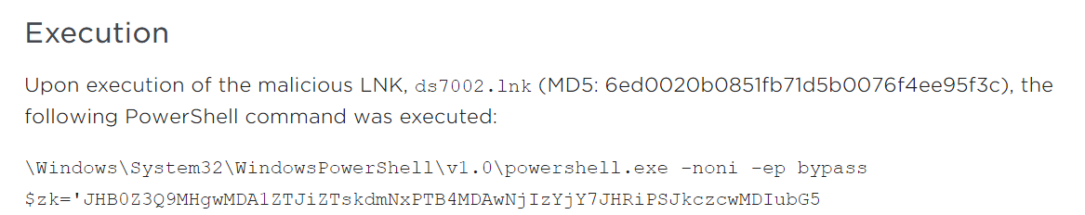
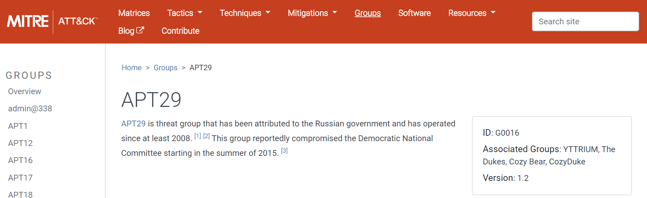
Example: APT29
https://www.fireeye.com/blog/threat-research/2018/11/not-so-cozy-an-uncomfortable-examination-of-a-suspected-apt29-phishing-campaign.html
Take a look at the techniques used:
Get some more info:
Notes:
Example of researching APT29 –
Browse FireEye report to get context of what they are doing
Research the technique further through ATTACK to get some more information

Slide 15
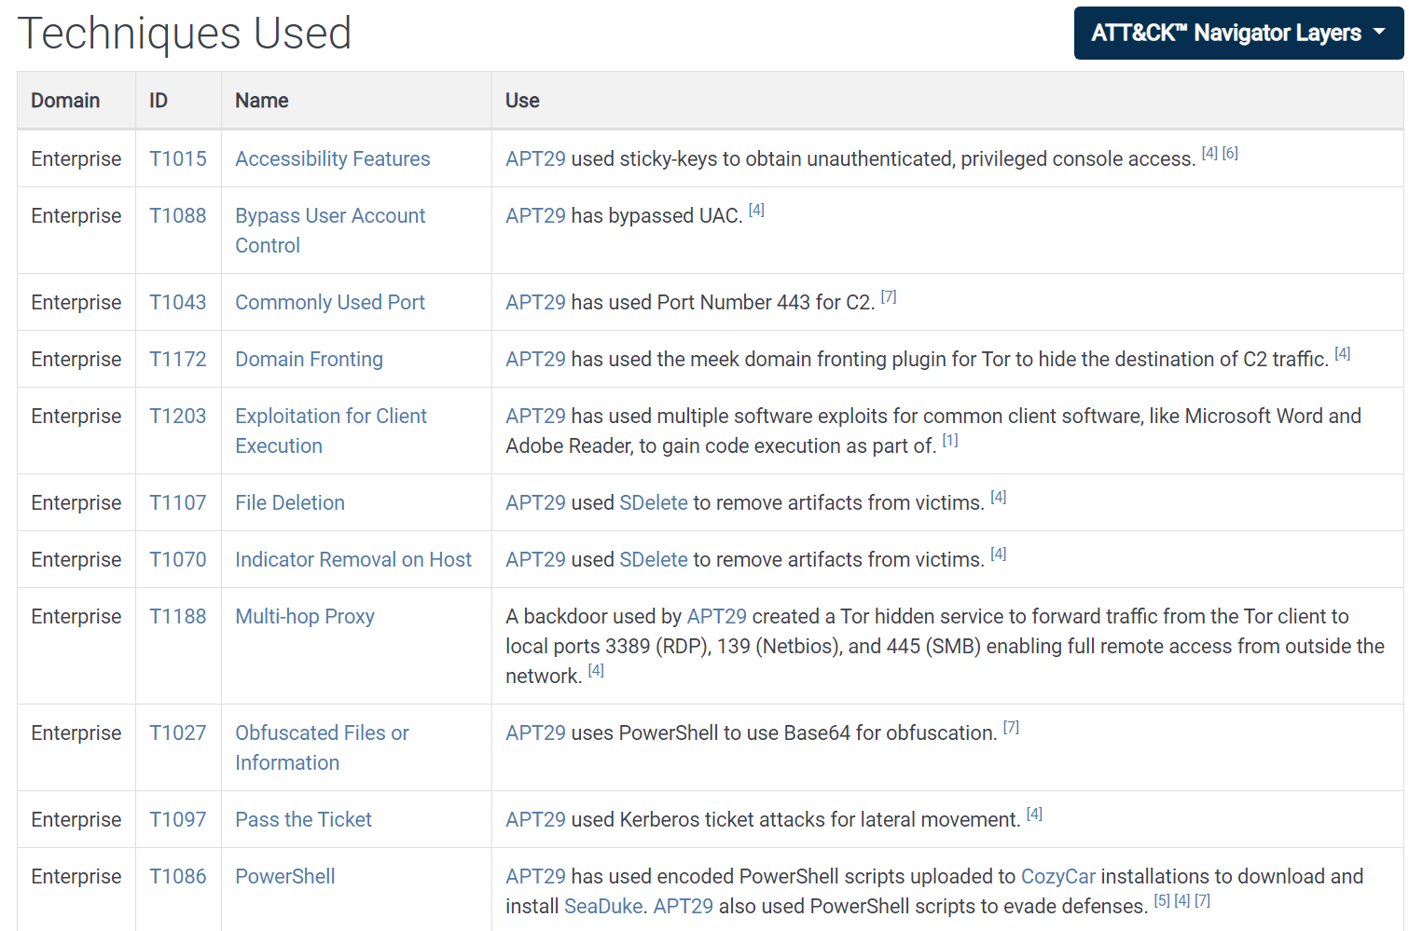
Notes:
Find the techniques that APT29 used and pick some that you could try to replicate in y our lab – stuff like Domain Fronting would be more difficult for example

Slide 16
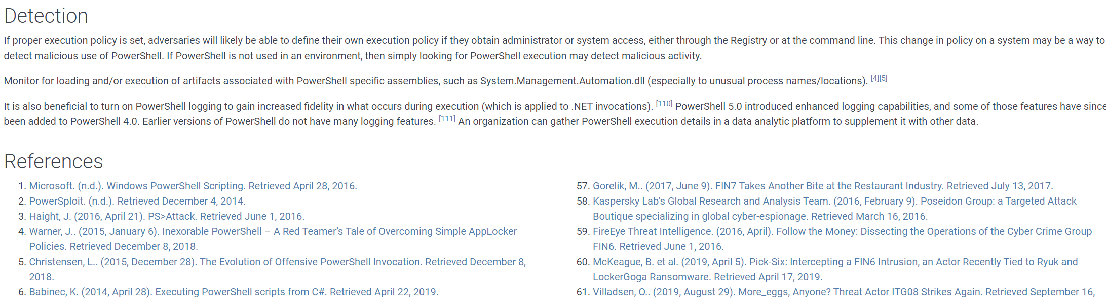
https://attack.mitre.org/techniques/T1086/
Notes:
Drill down into a technique, in this case PowerShell, contains enough information regarding detection to at least get you started followed by a bunch of reference links that you can follow and dig into

Slide 17
Research the technique used
Can you craft your own malicious PowerShell payload?
What is pass the ticket?
What tools do you need?
Try it in your lab
Make sure it’s local only, don’t do this stuff over the internet
Can you see any event data?
Does the malicious PowerShell stand out?
If not, research why not, figure out what needs to be turned on
Try to bypass your own detection
Can you obfuscate the PowerShell further?
Can you clear the event log, does that itself leave an event?
Can you steal your own credentials?
Remember the basics, there’s an OSI layer, some attacks can be seen on the wire and not the host

Slide 18
AppSec
Identity Mgmt
NSM
Assurance
Host Forensics
Windows Security
ReverseEng
Notes:
What I personally love about window security, there’s a ton of multiple disciplines involved and all of them are valid and will help you

Slide 19

Cool stuff, but I need a job
Notes:
Moving onto how to take these skills and transfer them into a workplace

Slide 20
Skills → Career
BAD:
“Users are stupid and click everything”
“These developers are so stupid, why can’t they just code a secure app”
“Who set Active Directory up this way, what an ******”
Why are these bad?
They don’t solve anything
You’re offering no solution
You aren’t getting paid to complain
Not Professional
“Everyone’s password sucks”
Notes:
I’ve personally heard the stuff on the left and I hate it – explain why

Slide 21

“I have done a password review of Active Directory and have determined that X percentage of users are susceptible to account compromise due to weak passwords, I have a phased roll-out plan that I’d like to work with service desk on in order to remediate this and lower our risk”

Slide 22
Remember
Business exists to make money; security is a major factor but there are always other drivers
Developers, IT, Users, InfoSec are all human
Resources are all limited, things were set up a certain way for (probably) a decent reason
Offer solutions to problems
Deliver value
Speak in terms business understands: Return on investment, risk, optimization, collaboration, enablement
Notes:
Some things to remember when you’re trying to implement stuff at the workplace, be it new security controls, processes, products, initiatives or anything
Business is there to make money, they really do care about security but they are often juggling a lot – that said, some companies may place less value on security than you’re comfortable accepting
Everyone is human and limited on resources, have some patience
Need to offer solutions to problems, not just identify them, that is what will set you apart
Deliver value, always think about what value will this bring to the workplace; ties into the last point
Speak in terms business wants to hear; risk reduction, return on investment, saving time on something, making something happen

Slide 23
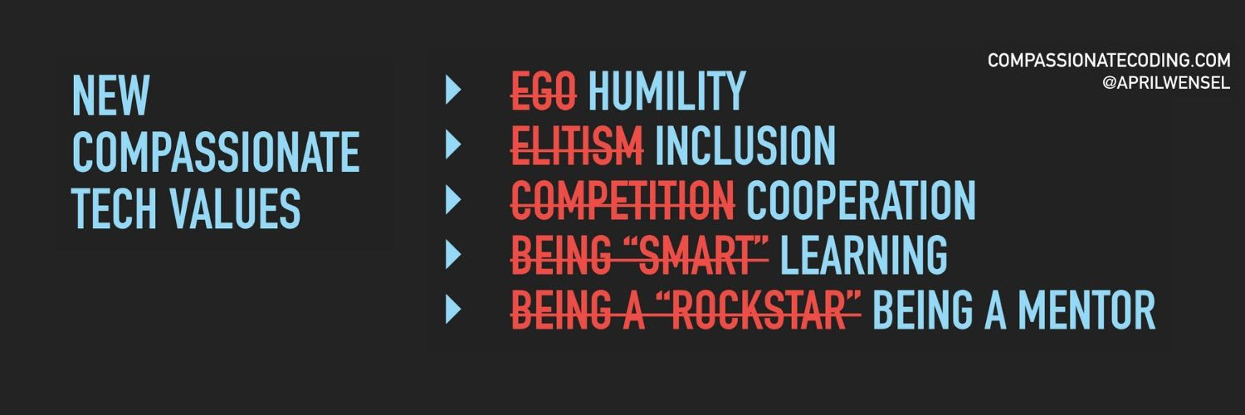
https://twitter.com/aprilwensel
- Be someone people enjoy working with.
Anything you want to implement at a workplace will require you to work with someone, “catalytic” skills are critically important.
Be someone people enjoy working with.
Notes:
I love this image from April Wensel – thinking like this has saved me a ton of stress at the workplace and has allowed me to just get more stuff done

Slide 24

Resources

Slide 25
www.ultimatewindowssecurity.com
Awesome resource for looking up event ids, includes samples
Adsecurity.org
Run by Sean Metcalf, a certified AD Master, spend a lot of time reading this site
https://app.any.run/submissions/
Any.run is a malware sandbox, look for reports on Windows system to get a good idea of what Malware is doing
https://www.fireeye.com/current-threats/threat-intelligence-reports.html
FireEye has some of the brightest minds of infosec
https://www.malwarearchaeology.com/
Tons of useful cheatsheets and guides
https://attack.mitre.org/
Database & Classification of attacker groups, techniques + tools
Notes:
Some resources that I find myself using all the time

Slide 26
https://www.trustedsec.com/blog/
http://blog.mdsec.co.uk/
https://posts.specterops.io/
https://www.blackhillsinfosec.com/blog/
https://dirkjanm.io/
https://adsecurity.org/
https://www.darkoperator.com/
https://blogs.technet.microsoft.com/jepayne/author/jessica-payne-msft/
https://thewover.github.io/
https://medium.com/threat-hunters-forge
https://devblogs.microsoft.com/powershell/powershell-the-blue-team/
http://www.exploit-monday.com/
http://carnal0wnage.attackresearch.com/
https://malwareunicorn.org/workshops/re101.html#0
https://github.com/hunters-forge/ThreatHunter-Playbook/tree/master/resources
https://www.sans.org/reading-room/
Notes:
Some resources that I find myself using all the time

Slide 27
https://github.com/chryzsh/awesome-windows-security
https://github.com/decalage2
https://blog.didierstevens.com/
https://medium.com/palantir/windows-event-forwarding-for-network-defense-cb208d5ff86f
https://thisweekin4n6.com/
https://www.invokethreat.actor/2018/09/leveraging-wef-and-helk.html
https://haveyousecured.blogspot.com/
https://www.endgame.com/blog
https://www.rapid7.com/research/under-the-hoodie/
https://www.sans.org/cyber-security-summit/archives/
https://www.ericconrad.com/
https://m0chan.github.io/2019/07/31/How-To-Attack-Kerberos-101.html
https://github.com/theevilbit/injection
https://blog.menasec.net/
https://github.com/neu5ron
https://medium.com/@cyb3rops
Notes:
Some resources that I find myself using all the time

Slide 28
Thank you ☺

